Slide 1
DATA ANALYTICS AND VISUALIZATION(IT508)
DATASET: Sample Super Market Store
Problem statement:
The main problem is to analyze supermarket sales and profit data to identify sales trend, high-performing regions, profitable product sub-categories, and opportunities to improve overall performance.
TEAM | VISIONX
Name : Amee Patel-240840116003
Nishtha Bilimoria-240840116010
Devanshi Desai-240840116023
Kavya Desai-240840116041
Himani Lad-240840116048

Slide 2
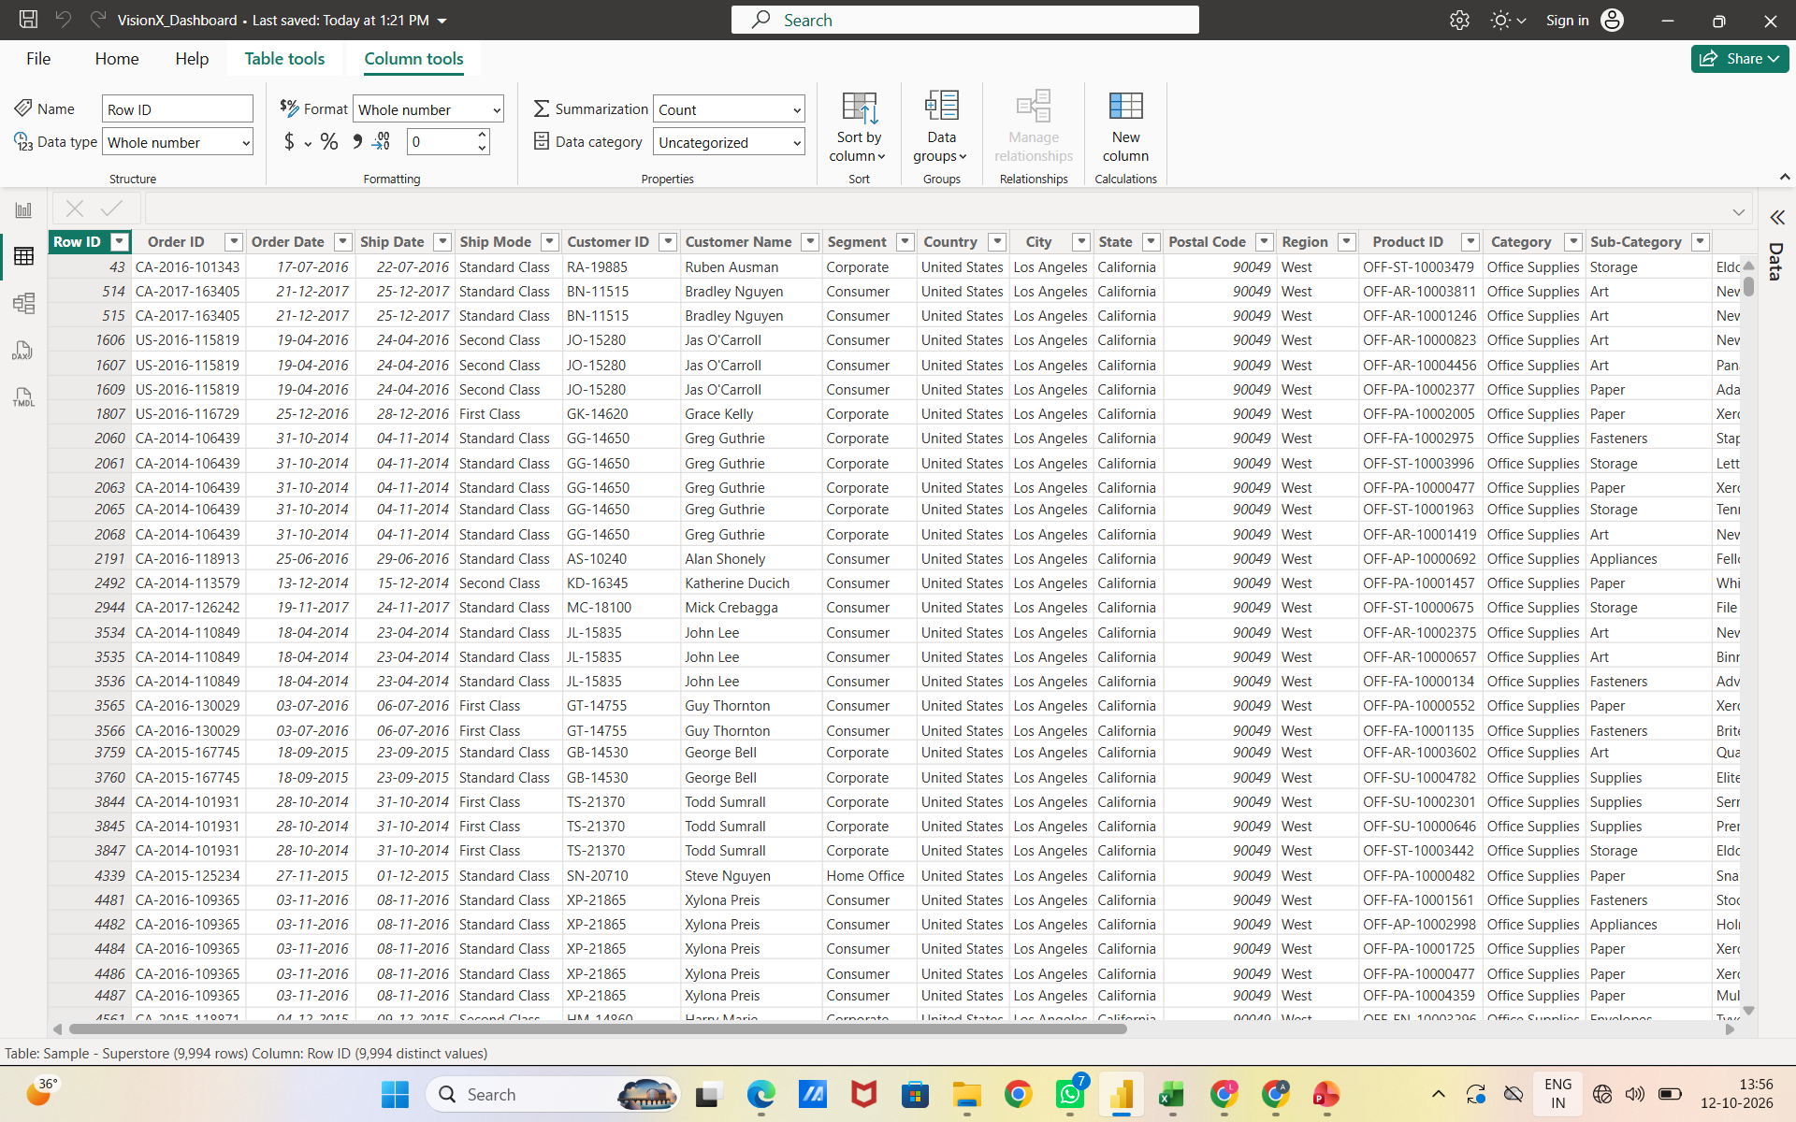
WHAT WE OBSERVED in RAW DATA
Raw Data Overview
Order Details: Contains Order ID, Order Date, Ship Date, and Ship Mode.
Customer Details: Includes Customer ID, Customer Name, and Customer Segment.
Geographical Details: Contains Country, City, State, Postal Code, and Region.
Product Details: Includes Product ID, Category, and Sub-Category.
Customer Segments: Customers are classified into Consumer, Corporate, and Home Office.

Slide 3
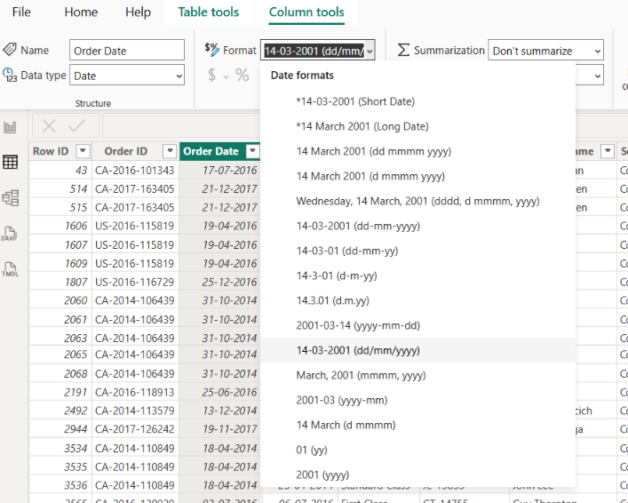
Data Cleaning
Date Format Correction
Problem: The Order Date and Ship Date columns had a date-format mismatch.
Action Taken: Changed the date format of both columns in Power BI.
Data Type: Ensured both columns use the Date data type.
Format Applied: Selected a consistent date format, such as DD-MM-YYYY.
Result: Dates are displayed consistently, making date-based filtering and time-series analysis easier.

Slide 4
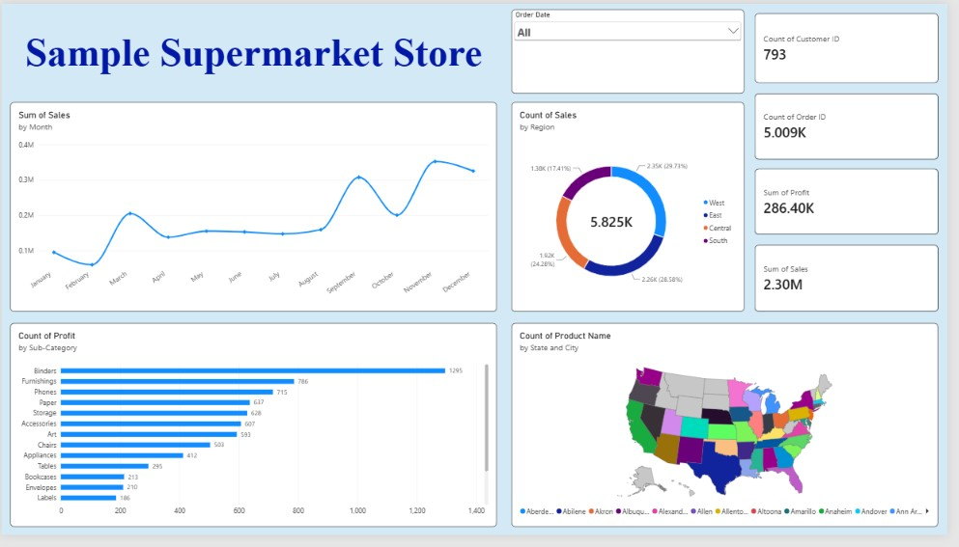
dashboard

Slide 5
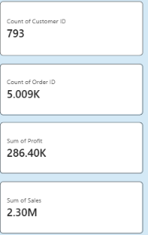

KPI Cards & Order Date Slicer
Count of Customer ID: 793
Purpose: To measure customer activity.
Insight: The dataset contains 793 counted customer IDs.
Count of Order ID: 5.009K
Purpose: To measure order activity.
Insight: Approximately 5,009 order IDs are counted.
Sum of Profit: 286.40K
Purpose: To measure total profit earned.
Insight: The total recorded profit is approximately 286,400.
Sum of Sales: 2.30M
Purpose: To measure total sales revenue.
Insight: Total recorded sales are approximately 2.3 million.
SLICER CHART:
Purpose: To filter the dashboard based on the selected order date .
Insight: Currently, All is selected, so the dashboard displays data for all available order dates.

Slide 6
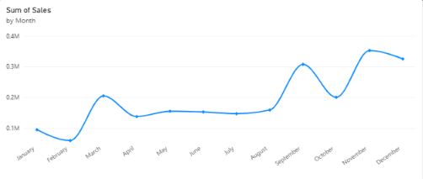
line Chart : Sum of Sales by Month
Purpose: To understand how total sales change from month to month.
What it shows: The horizontal axis represents months from January to December, while the vertical axis represents the sum of sales.
Insights
January sales are approximately 0.10M.
Sales decline in February before increasing sharply in March.
Sales remain relatively stable from April through August.
Sales rise sharply in September, decline in October, and reach their highest level in November.
December sales decrease slightly from November but remain high.

Slide 7
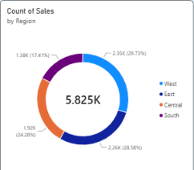
Donut Chart : Count of Sales by Region
Purpose: To compare sales-record distribution across four regions.
Regions shown: West, East, Central and South.
Insights
West has the largest reported share.
East is close behind West.
Central contributes approximately one-quarter of the displayed distribution.
South has the smallest reported share.
Region | Percentage shown
West | 29.73%
East | 28.58%
Central | 24.28%
South | 17.41%

Slide 8
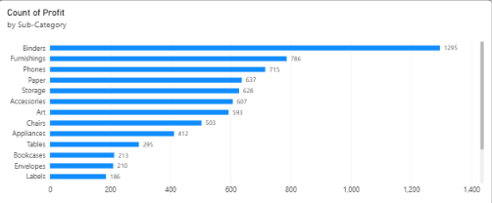
Horizontal bar Chart : Count of Profit by Sub-Category
Purpose: To compare the displayed profit-related counts for different product sub-categories.
What it shows: Longer bars represent higher counts in the selected measure.
Insights
The supermarket should analyze product sales and profit to identify the most profitable sub-categories.

Slide 9
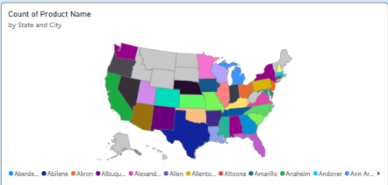
Filled map Chart : Count of Product Name by State and City
Purpose: To visualize the geographical distribution of product records across states and cities.
What it shows: Geographic areas are colored to distinguish data associated with different locations or categories.
Insights
The map displays the United States, with multiple states shown in different colors.
The visualization suggests that the dataset contains location information for many states and cities.
The colored map alone does not clearly establish which state has the most products because the colors appear categorical and the legend is crowded.
The map does not, by itself, demonstrate which states generate the highest sales or profit.

Slide 10
Recommendations – SamplE
Supermarket Store Dashboard
Improve Sales: Investigate low-sales months and plan seasonal promotions.
Regional Performance: Focus on improving sales in regions with lower activity, especially South.
Product Analysis: Identify the most profitable sub-categories using total profit, not just count.
Customer Retention: Introduce loyalty programs to encourage repeat purchases.
Inventory Management: Maintain sufficient stock for high-demand products such as Binders.
Delivery Analysis: Compare Order Date and Ship Date to identify shipping delays.
Dashboard Improvement: Correct inconsistent chart totals and add clear labels to the map.

Slide 11
Thank YOU!!

